Slide 1
Predicting disulfide bond connectivity in proteins by correlated mutations analysis
Rotem Rubinstein and Andras Fiser
10.1093/bioinformatics/btm637 Vol. 24 No. 4. 2008, pages 498–504
Presenter : Chih-Ying Lin
Date : Aug. 04, 2009

Slide 2
Abstract
Motivation: Prediction of disulfide bond connectivity facilitates structural and functional annotation of proteins. Previous studies suggest that cysteines of a disulfide bond mutate in a correlated manner.
Results: We developed a method that analyzes correlated mutation patterns in multiple sequence alignments in order to predict disulfide bond connectivity. Proteins with known experimental structures and varying numbers of disulfide bonds, and that spanned various evolutionary distances, were aligned. We observed frequent variation of disulfide bond connectivity within members of the same protein families, and it was also observed that in 99% of the cases, cysteine pairs forming non-conserved disulfide bonds mutated in concert. Our data support the notion that substitution of a cysteine in a disulfide bond prompts the substitution of its cysteine partner and that oxidized cysteines appear in pairs. The method we developed predicts disulfide bond connectivity patterns with accuracies of 73, 69 and 61% for proteins with two, three and four disulfide bonds,
respectively.

Slide 3
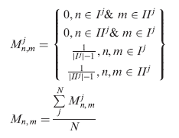
Prediction method
A={Alignment positions (columns) corresponding to the query bound cysteines}
I^{j}={i | i є A & Position i in sequence j is a cysteine}
II^{j}={i | i є A & Position i in sequence j is not a cysteine}

Slide 4
Example
pepa_human 107–112, 268–272, 311–344
 | 107 | 112 | 268 | 272 | 311 | 344
AAA23476 | - | - | C | C | C | C
XP_61523 | C | C | A | L | C | C
 | I | II
AAA23476 | 268, 272, 311, 344 | 107, 112
XP_61523 | 107, 112, 311, 344 | 268, 272

Slide 5
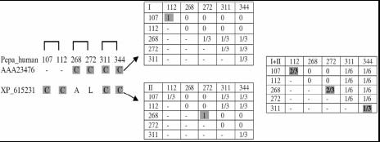
Example

Slide 6
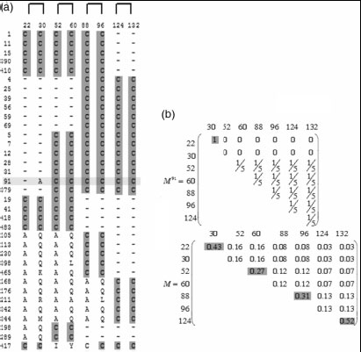
Example

Slide 7
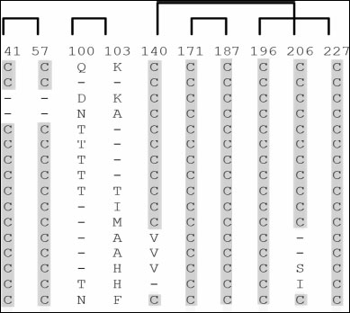
Example

Slide 8
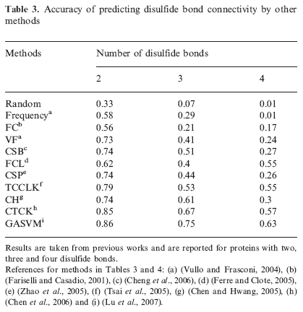
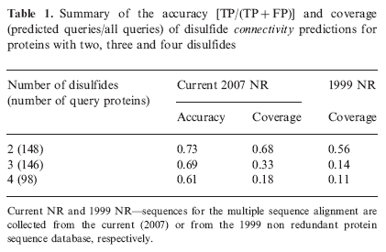
Result

Slide 9
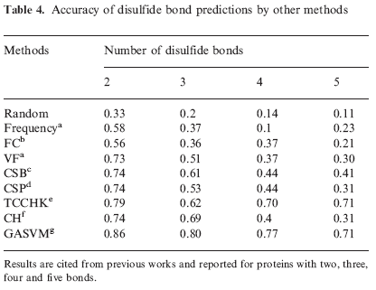
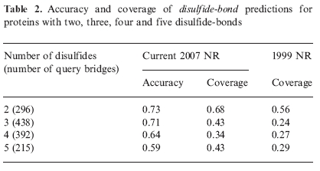
Result

